Slide 1









Fuzzy logic
A Brief Overview
Reetam Das
with the help of DR. Biplab Ranjan Sarkar

Slide 2
What is Fuzzy logic!
Fuzzy Logic(FL) is a method of reasoning that resembles Human Reasoning. This approach is similar to how humans perform decision Making. It is not just Yes or No, but all intermediate possibilities included.
Fuzzy logic is an approach to computing based on "degrees of truth" rather than the usual "true or false" (1 or 0) Boolean logic on which the modern computer is based.

Slide 3
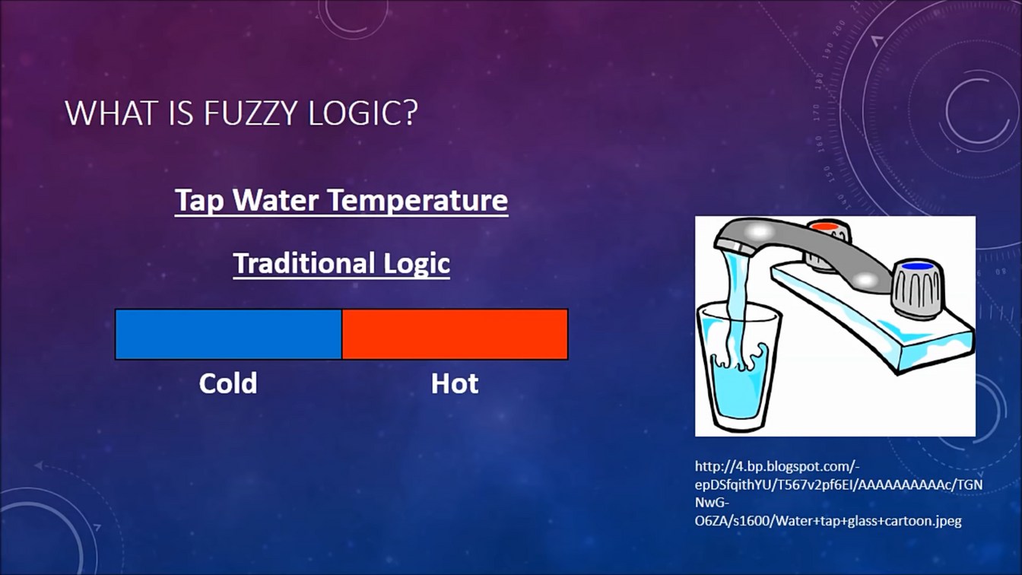
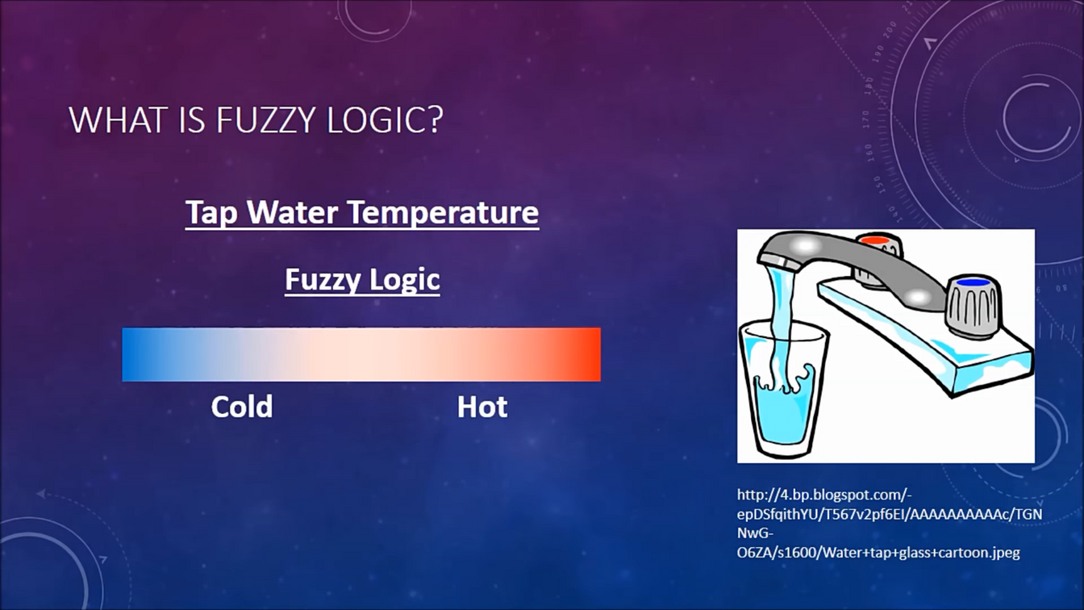
Boolean Logic vs Fuzzy Logic
Boolean Logic | Fuzzy Logic

Slide 4
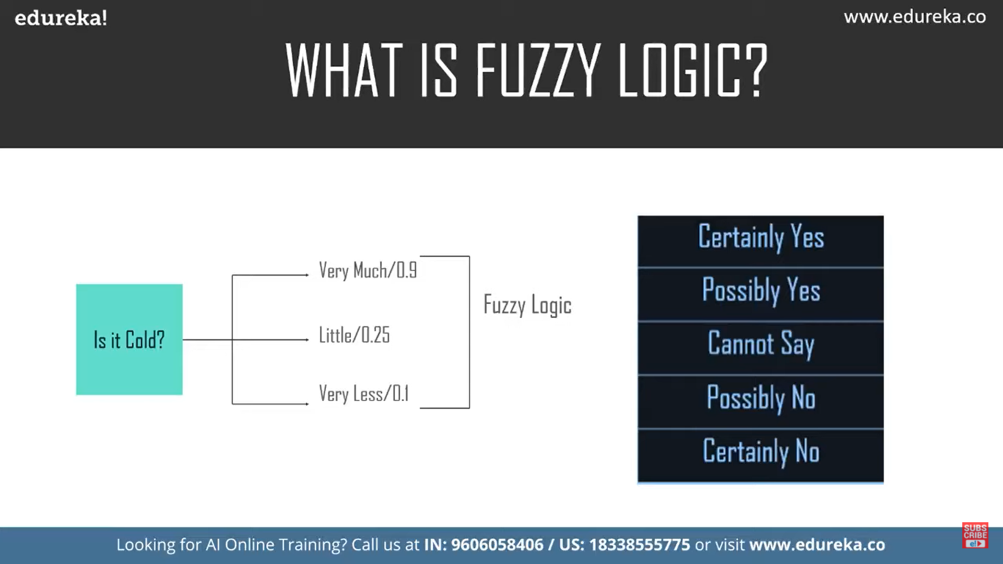
Degree of Truth in Fuzzy Logic

Slide 5
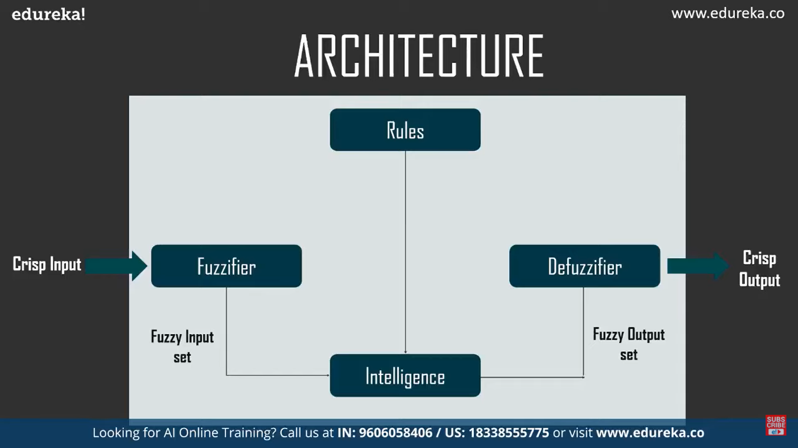

Slide 6
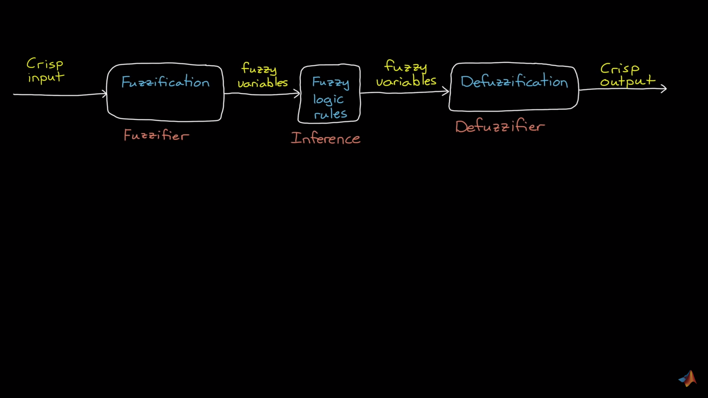
Basic Process

Slide 7
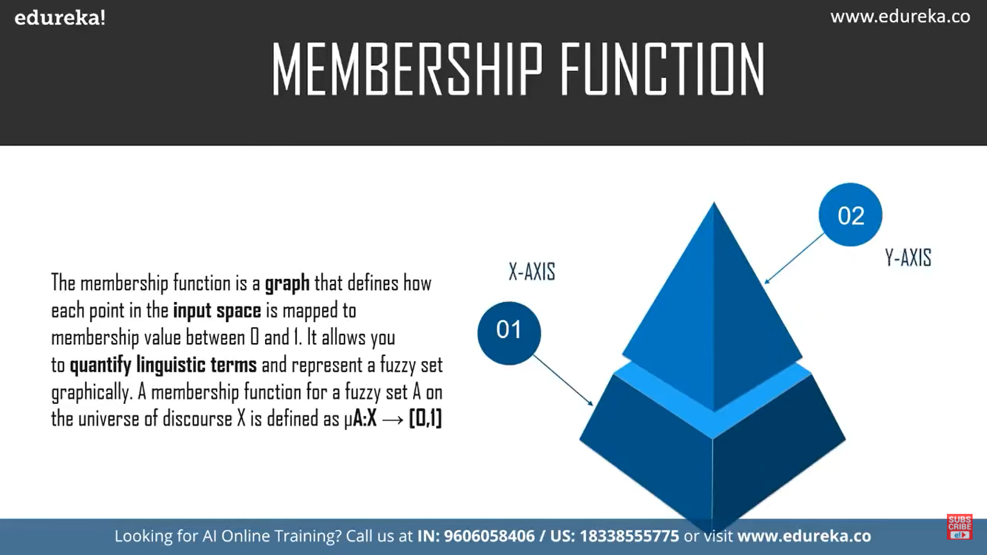
Membership Function

Slide 8
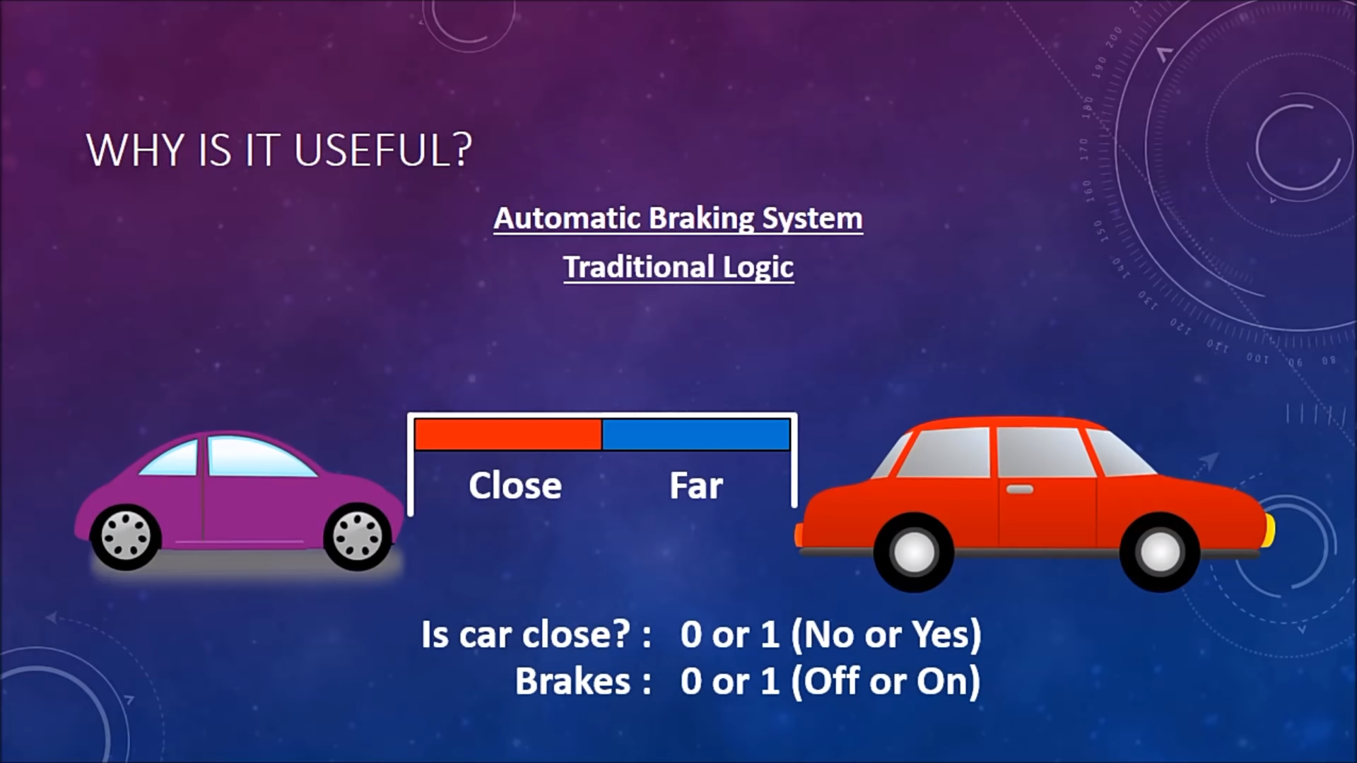

Slide 9
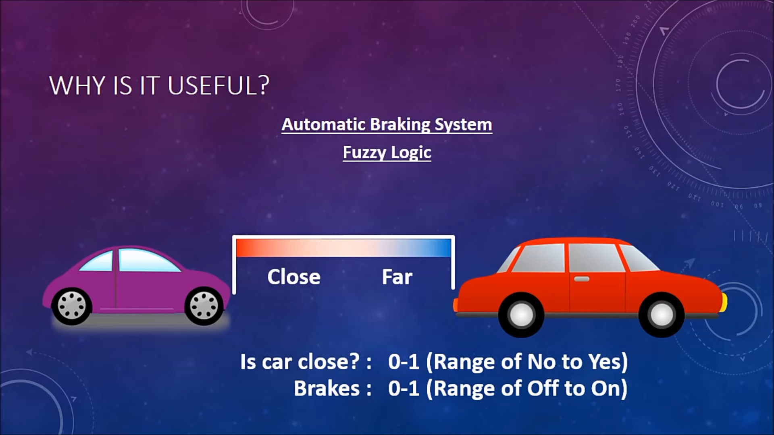

Slide 10
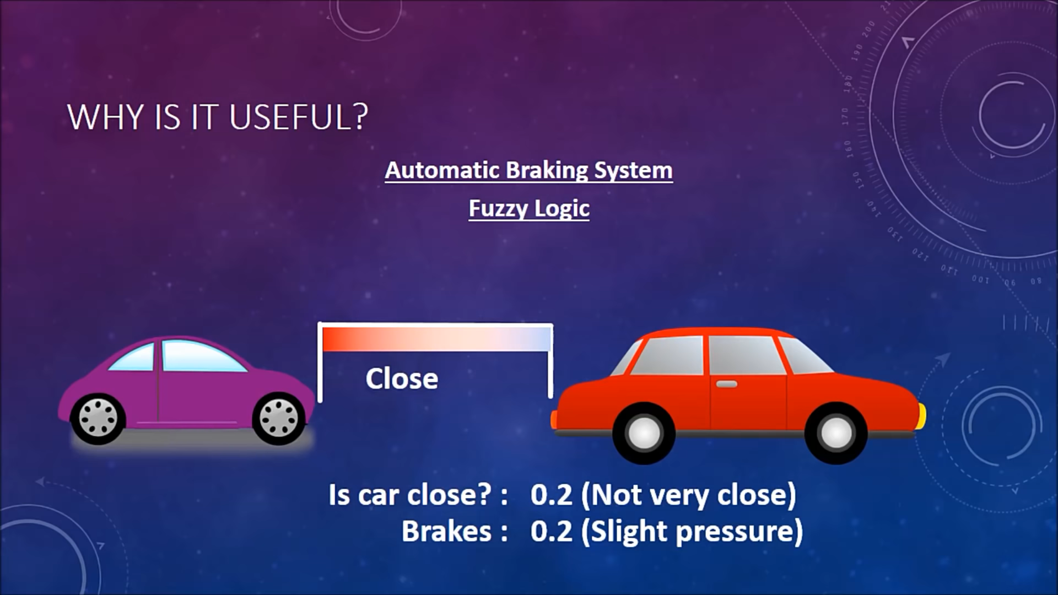

Slide 11
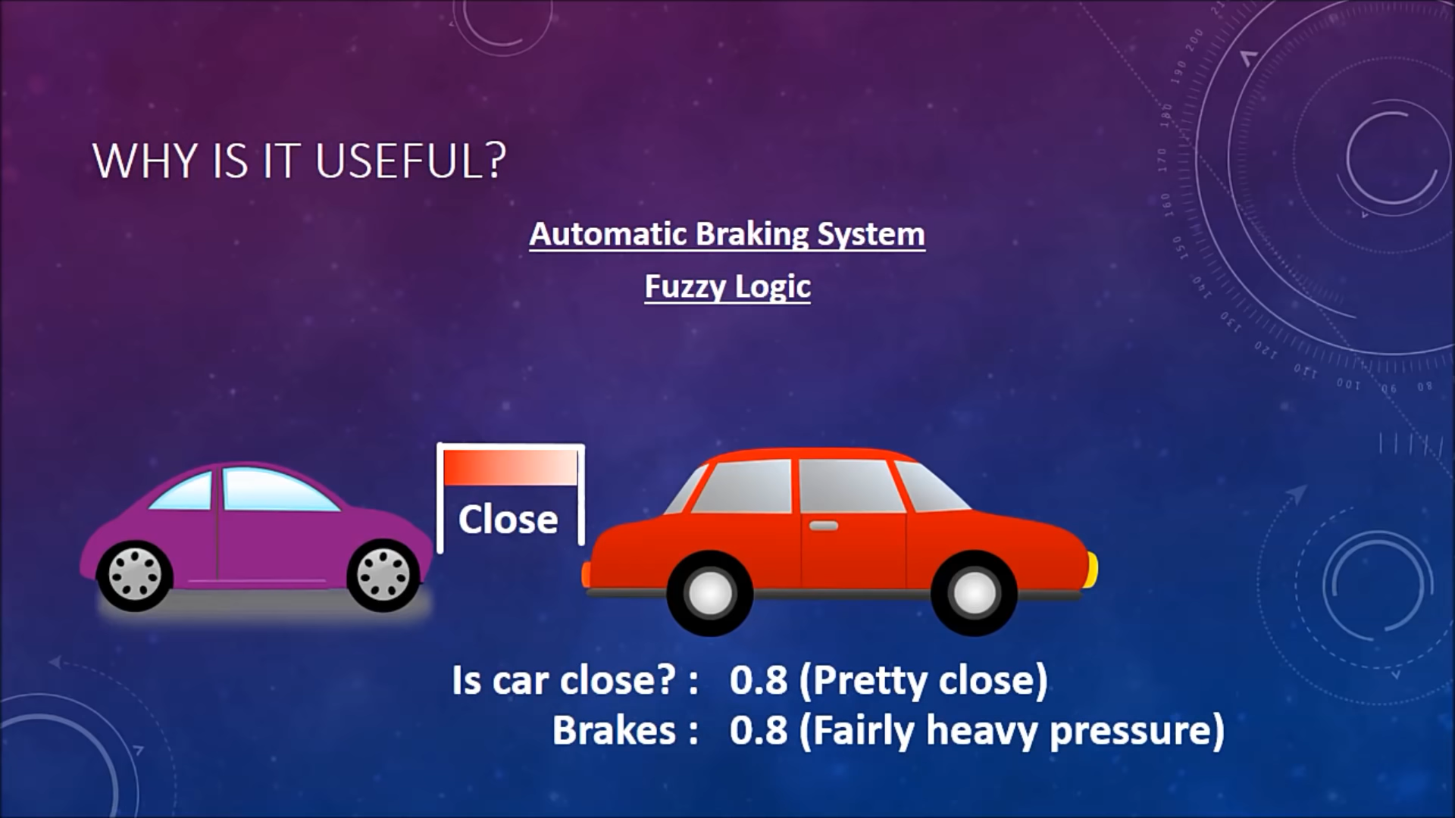

Slide 12
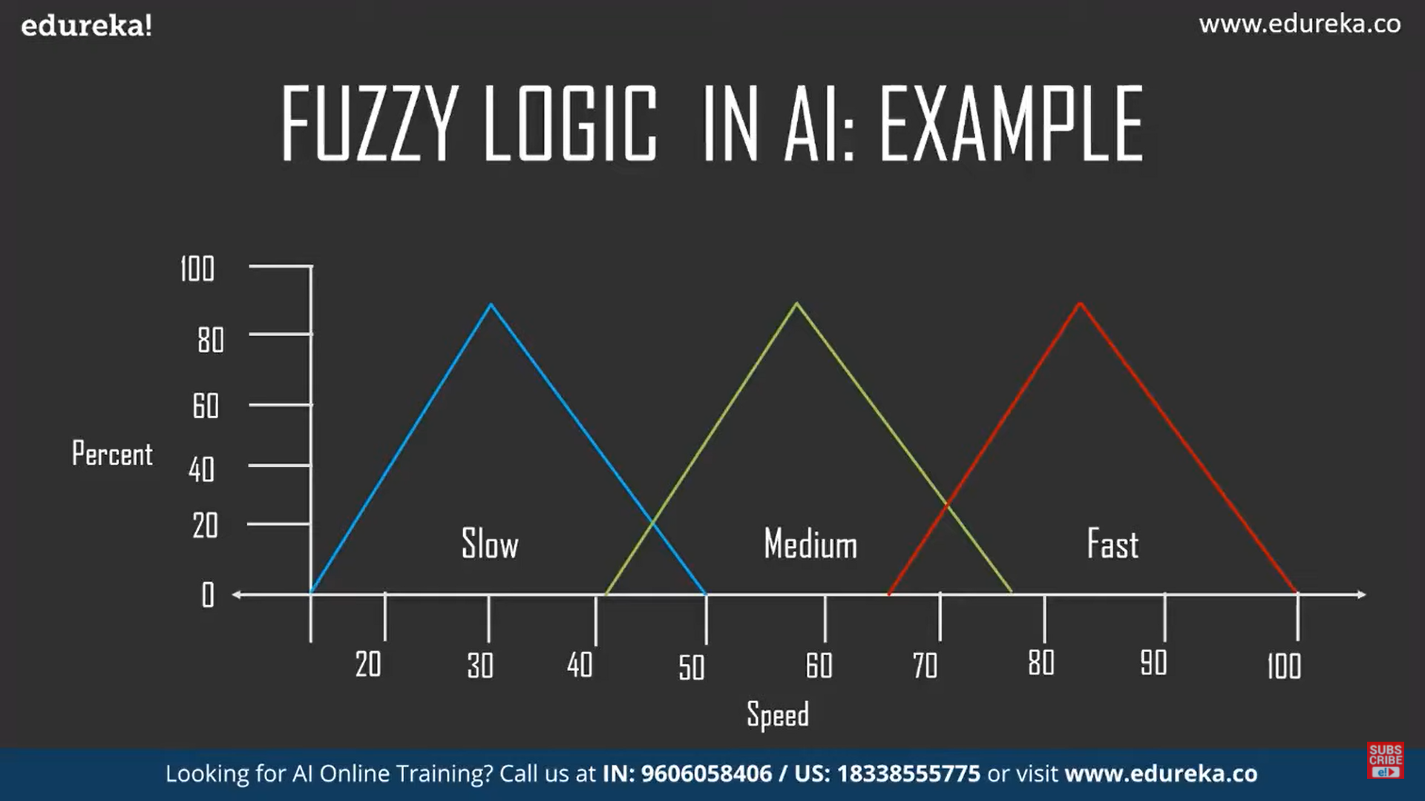
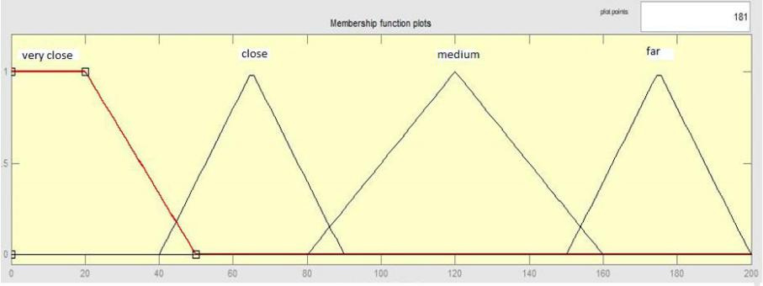

Slide 13
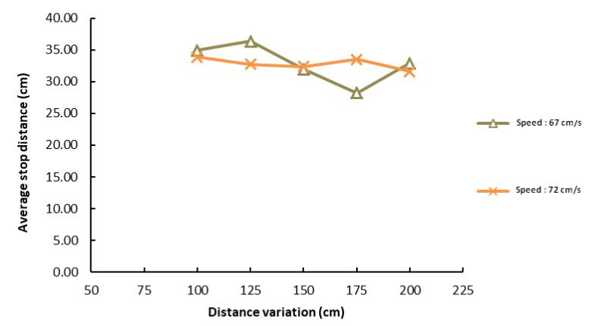
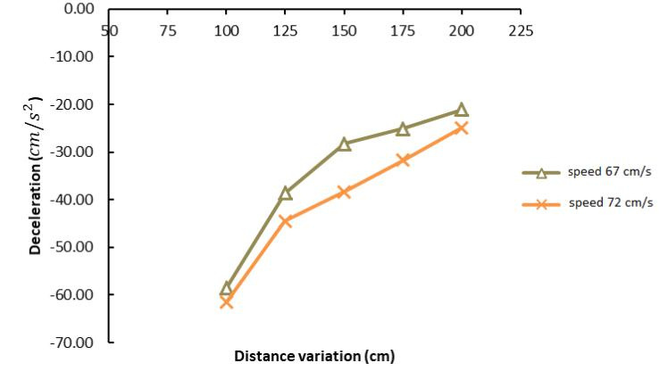
The Distance vs Speed Graphs
Figure is a graph of the relationship between the average stopping distance of the prototype car against the variation of distance and speed.
Figure 6 is a graph of deceleration of prototype car testing results against variations in distance and speed.

Slide 14
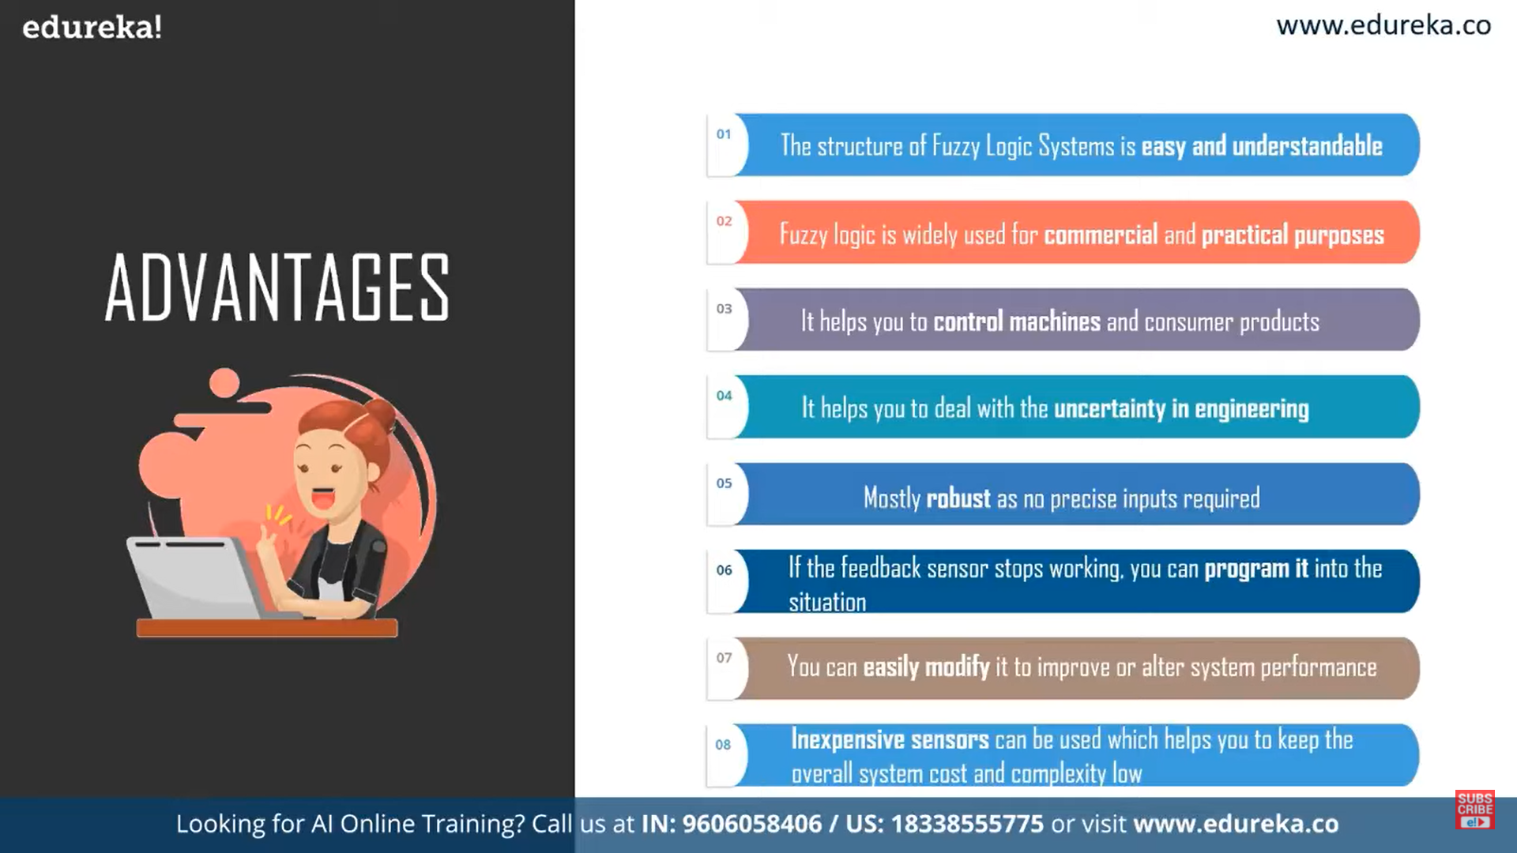

Slide 15
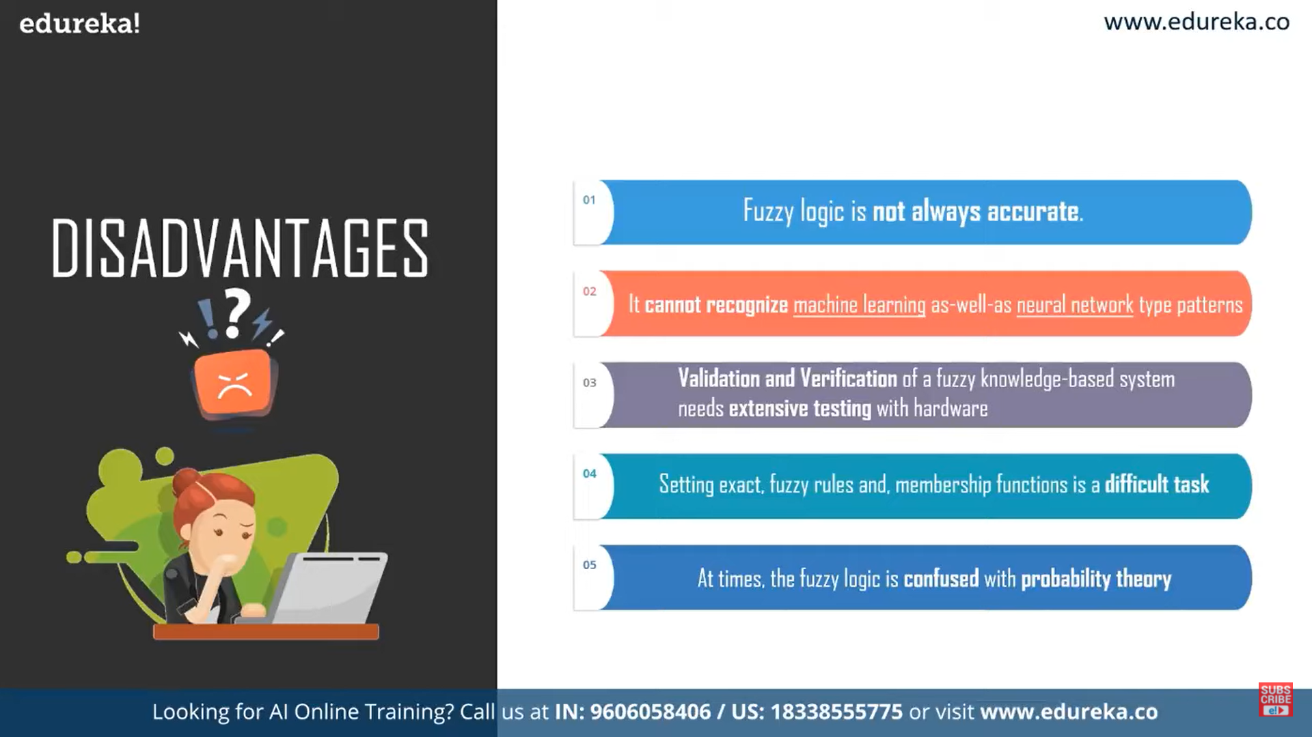

Slide 16

Thank You
By: Reetam Das
guided by: Dr. Biplab Ranjan Sarkar

